Slide 1
books collection
The App contains all the previous materials of certain institution.

Slide 2
Introduction
It was a app that used to open the previous year and current year or sem materials in the pdf form using the javaswing.

Slide 3
overview
This App gives us the books and materials on the basis of the sem and year you wish.
We can add our Materials to this book.
It reduces the students time for searching on previous year books and materials for their studies.

Slide 4
Packages used
import javax.swing.*; //swing frame
import java.awt.*; //to import the abstract window tool kit package
import java.io.IOException; //to handle IoExceptions
import java.awt.event.*; // to handle events when buttons is pressed
import javax.swing.filechooser.FileNameExtensionFilter;
import java.io.File;//for adding file

Slide 5
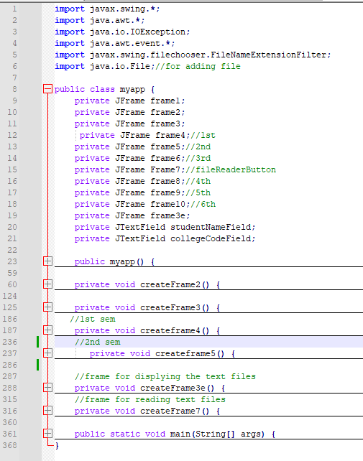
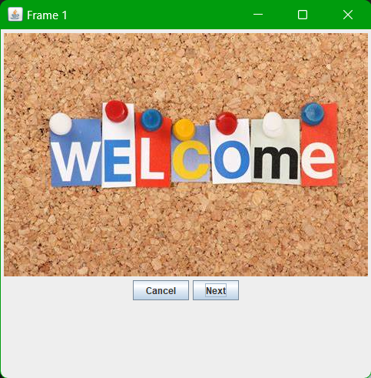
Codes and first frame

Slide 6
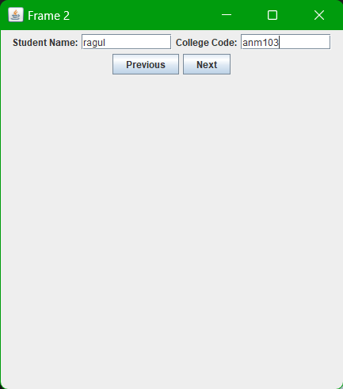
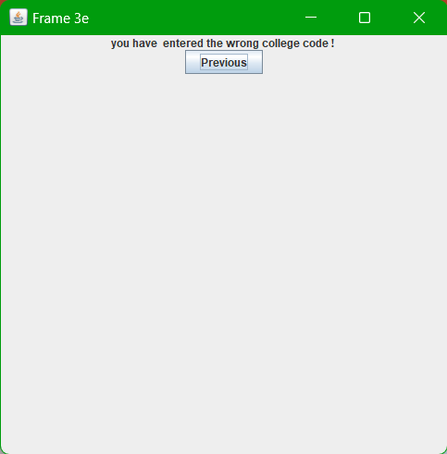
Student details
It only works for our college code only “Anm103” other wise it displays a content in frame 3e.

Slide 7
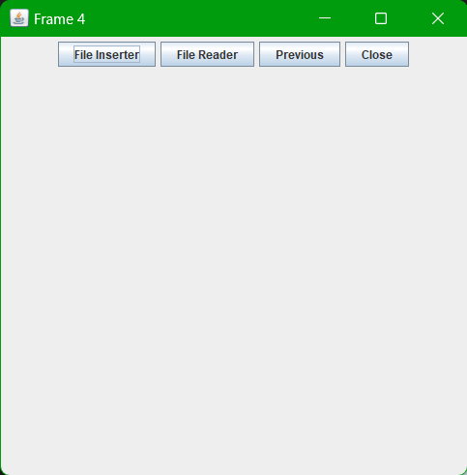
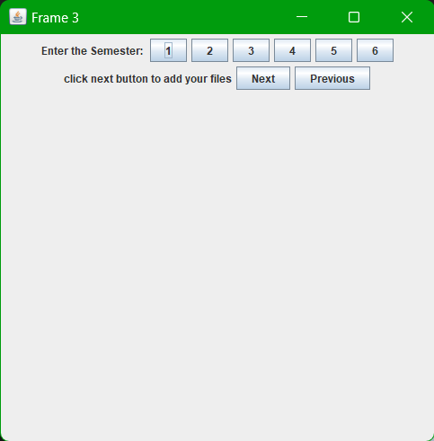
File insertion and sem details
File insertion and books viewing was done on the frame 4.
After this we can select the semester details in which we need the book for and also we can chose the next for adding our files.

Slide 8
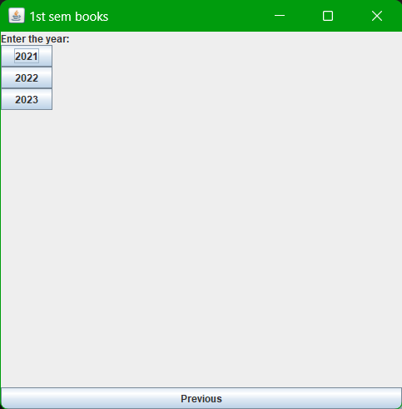
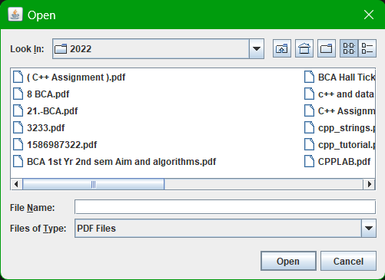
Year and book choosing
As for example I choose a 1st sememester To get books and materialS in 1st sem(as I apploaded ).

Slide 9
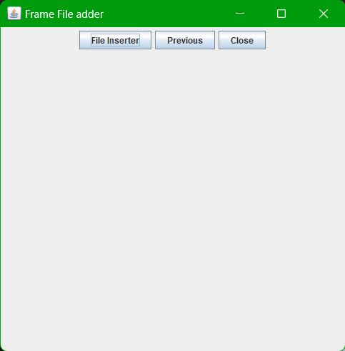
File insertion
File insertion was done on the file instertion frame using the import java.io.File; package. The file insertion can be done only for files with extension .pdf (pdf files only uploaded).

Slide 10
Conclusion:
So that the pdf uploaded on a certain place can be accessed by all suing the swing.

